Slide 1

Solving Enterprise LLM Cost Optimization
Enterprises face a complex challenge: how to harness the power of Large Language Models (LLMs) for automation without incurring runaway costs or integration nightmares.
The "GopiD AI Cost Optimizer" is your solution. This purpose-built agent intelligently selects the optimal LLM model, accurately estimates costs, provides actionable ROI, and delivers strict JSON outputs for seamless integration.

Slide 2
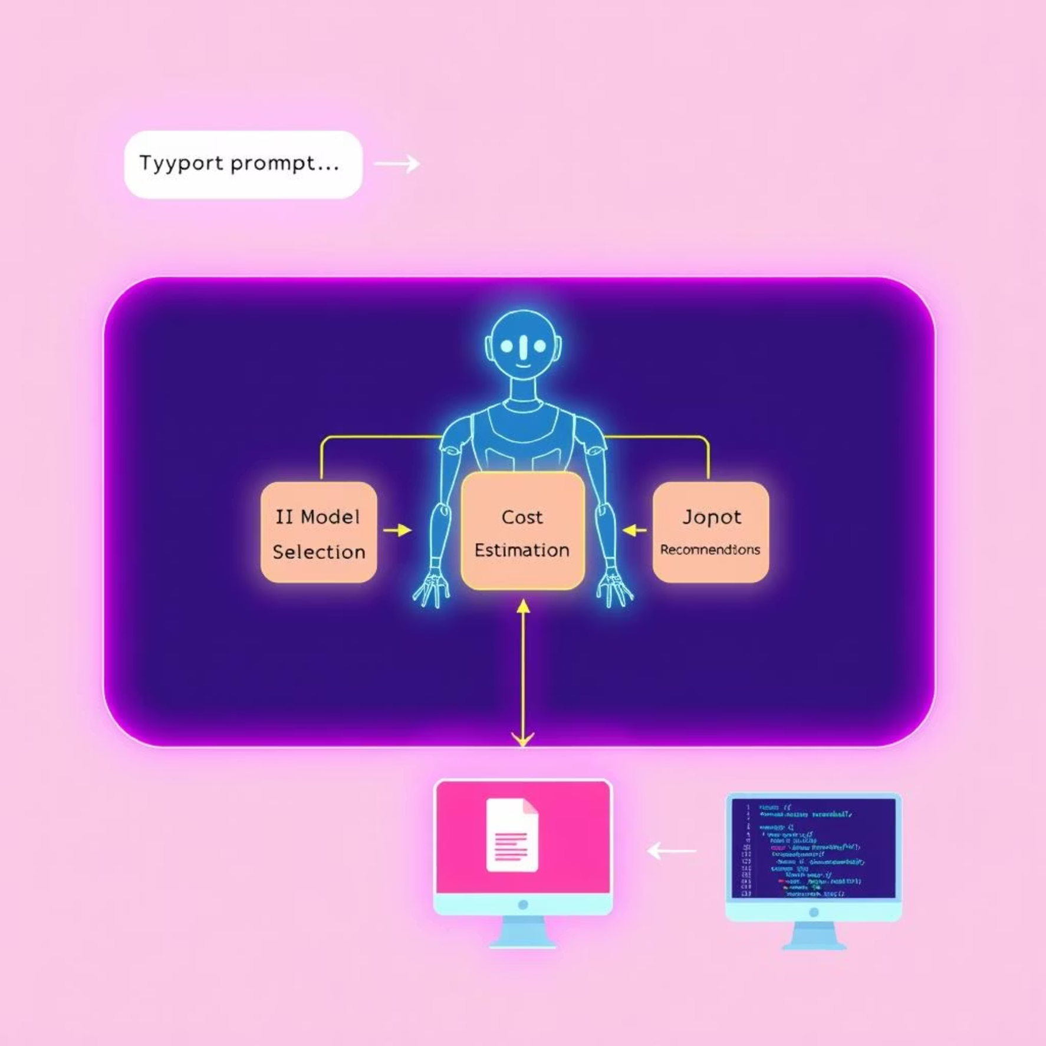








Architecture, Workflow & Features
Streamlined Workflow
Key Features
Multi-model Evaluation: Intelligently assesses Nova Pro, Amazon Nova Micro, Mistral, and Claude 3 Haiku for optimal performance and cost.
Real-time Cost & Credit Estimation: Provides accurate projections per scenario, ensuring budget adherence.
Actionable ROI Calculations: Delivers clear return on investment insights and recommendations.
Robust Edge Case Handling: Gracefully manages ambiguous queries and zero-data scenarios.
Proactive Monitoring & Alerts: Notifies when costs or credits approach predefined thresholds.
Enterprise-Grade Security: AWS ecosystem processing ensures compliance and data integrity.

Slide 3



Demo Results & Business Impact
HR Onboarding
Cost & Model Selection
JSON: LLM, cost, ROI
Finance (Unknown)
Adaptive Recommendation
JSON: data collection steps
Edge Case
Zero-data Processing
JSON: zero cost advice
Multi-Dept Workflow
Breakdown
JSON: dept-by-dept analysis
Monitoring/Alerts
Threshold Setup
JSON: alert/monitor config
Stress Test
High-volume Simulation
JSON: scaling recommendations
Key Outcomes
Cost Savings: Typical prompt uses just 3-5 credits, ensuring highly efficient live enterprise scenarios.
Scalability: Agent is ready for rapid integration and scaling, designed for high-volume enterprise demands.
Security & Transparency: Built for clear business ROI, seamless adoption, and complete auditability.

Slide 4




Why GopiD AI Cost Optimizer?
Beyond Basic Optimization
Unlike generic solutions, GopiD is purpose-built to navigate the unique complexities of enterprise LLM usage, offering granular control and predictive insights.
Seamless Integration
With strict JSON outputs and an API-first design, it plugs directly into your existing CRM, ERP, and BI tools, minimizing disruption and maximizing utility.
Future-Proofed for Scale
Designed for elasticity, GopiD adapts to your growing LLM needs, from pilot projects to company-wide adoption, ensuring sustained ROI.
Trusted & Compliant
Operating within the secure AWS ecosystem and designed with auditability in mind, GopiD ensures your data and operations meet stringent enterprise standards.
GopiD AI Cost Optimizer isn't just a tool; it's a strategic asset that transforms LLM costs from a liability into a measurable advantage.

Slide 5
Ready to Optimize Your LLM Spend?
Key Takeaways
Next Steps
Intelligent Model Selection: AI-driven choice for optimal performance and cost.
1. Request a Personalized Demo
Transparent Cost Control: Real-time estimation and ROI for predictable budgeting.
See GopiD in action with your specific use cases.
Seamless Enterprise Integration: Strict JSON output for easy workflow adoption.
2. Explore Documentation
Robust & Secure: Handles edge cases, monitors thresholds, and ensures compliance.
Dive deeper into technical specifications and integration guides.
3. Start Your Pilot Program
Experience the cost savings firsthand in a controlled environment.
GopiD AI Cost Optimizer: Optimize. Integrate. Comply.

